Slide 1
Transition and Training
Quaestor

Slide 2
You Have been Elected…Now What?
Its Time to Assess your Strengths and Areas of Growth!
Partner with the Outgoing Quaestor
Leverage your Chapter Advisors and/or Financial Advisors

Slide 3
Technical Skills Assessment
Financial Management Skills
Bookkeeping
Budgeting
Collections
Record Keeping
Tax Reporting
Meeting Deadlines

Slide 4
Human Skills Assessment
Managing Relationships
Social Intelligence
Emotional Intelligence
Communication Skills
Presentation Skills
Maintaining Confidentiality

Slide 5
Conceptual Skills Assessment
Organization
Time Management
Forecasting
Following Procedure
Training Skills

Slide 6
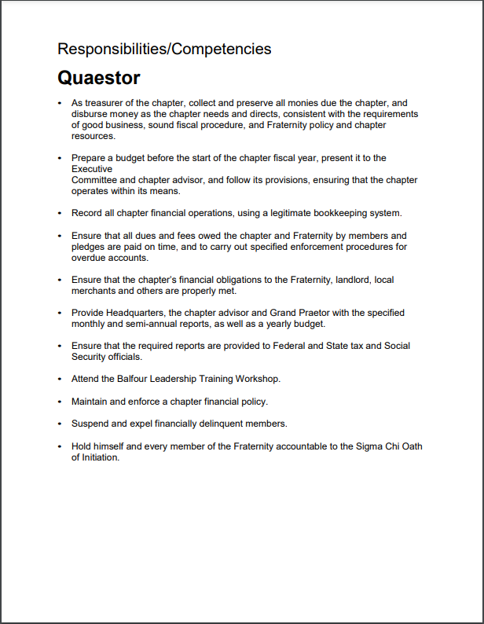
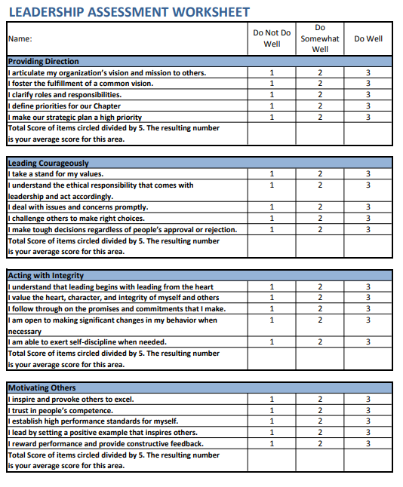
Skills Assessment Continued

Slide 7
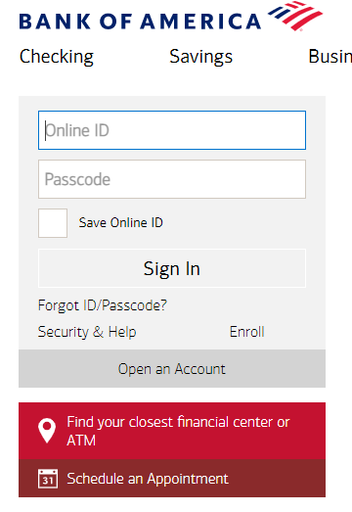
Financial Systems Access
Chapter financial software
Chapter financial banking accounts
Sigma Chi chapter portal
Campus-related systems
Risk Management Foundation login/password
Authorized representative for utility companies
Any other systems the Quaestor uses to manage the finances of the chapter

Slide 8
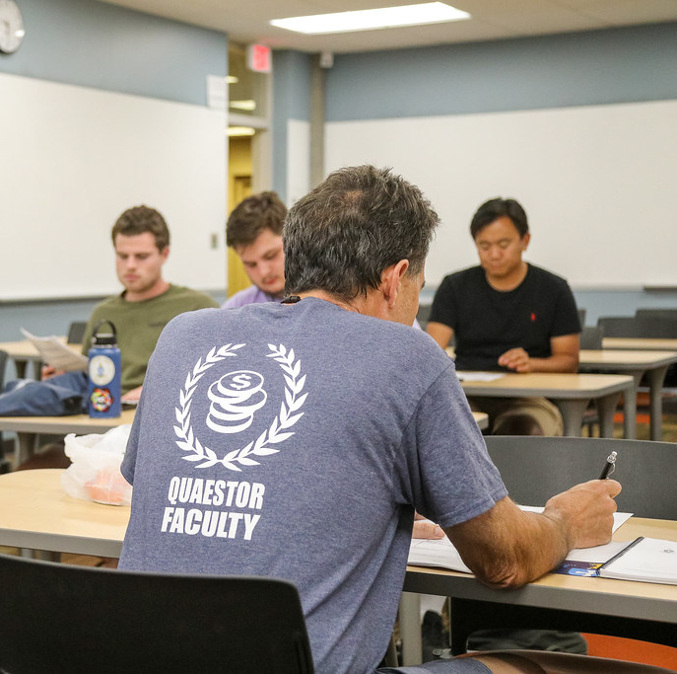
Day to Day Tasks
Demonstrate the Financial Software
Financial Software Training Videos
Navigate your Financial Institution Website
Membership’s Financial Status Download
Financial Report to the Chapter

Slide 9
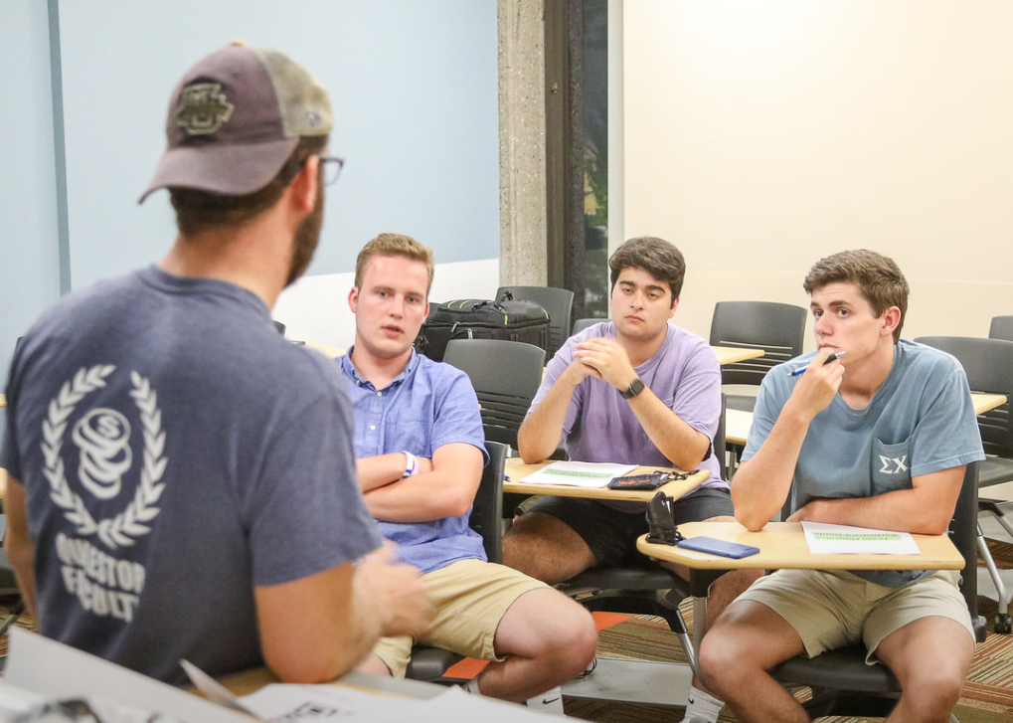
Day to Day Tasks
Don’t wait to start your transition and training
Seek out Mentorship
Use all the Training Resources at your Disposal
Sigmachi.org/home/leadership-resources/

Slide 10
Thank you!!!
Quaestor

