Slide 1
Finance Committee Operations
Quaestor

Slide 2
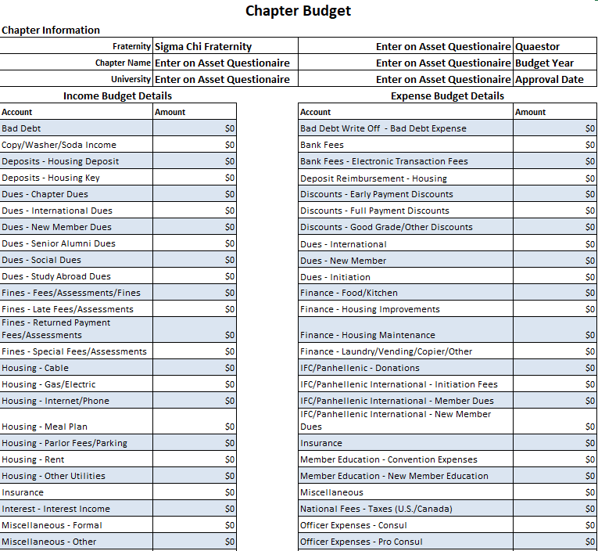
Budget Preparation
Seek Input from the Recruitment Chairmen, other Executive Committee Officers and Alumni Financial Advisors.

Slide 3
Financial Controls
Pledge Fees
Initiation Fees
Formal
Social Events
Chapter Budget approval should occur within 3 Weeks of each Academic Term!

Slide 4
Financial Controls Continued
Consistently Review the Following
Financial Statements
Access to Debit/Credit Cards
Receipts of Collections and Payments
Bank Statements
Copies of Invoices

Slide 5
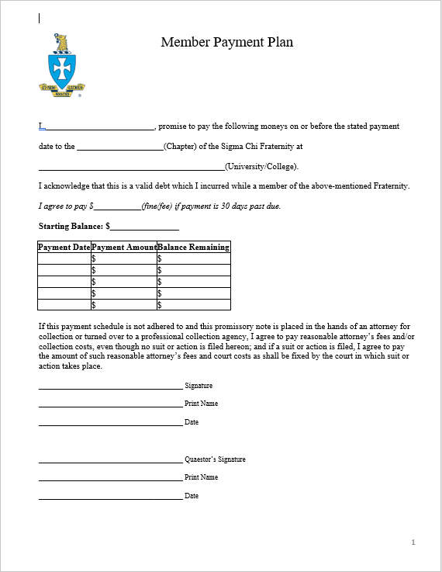
Payment Contracts
Fair and Equitable Treatment is Imperative!

Slide 6
Payment Plans Continued
Things to Consider
Did he request help before he was in arrears?
Is the Brother active the chapter?
Payment History
Are there special circumstances?
Is the payment plan realistic?
Will he clear his debt before he leaves school?

Slide 7
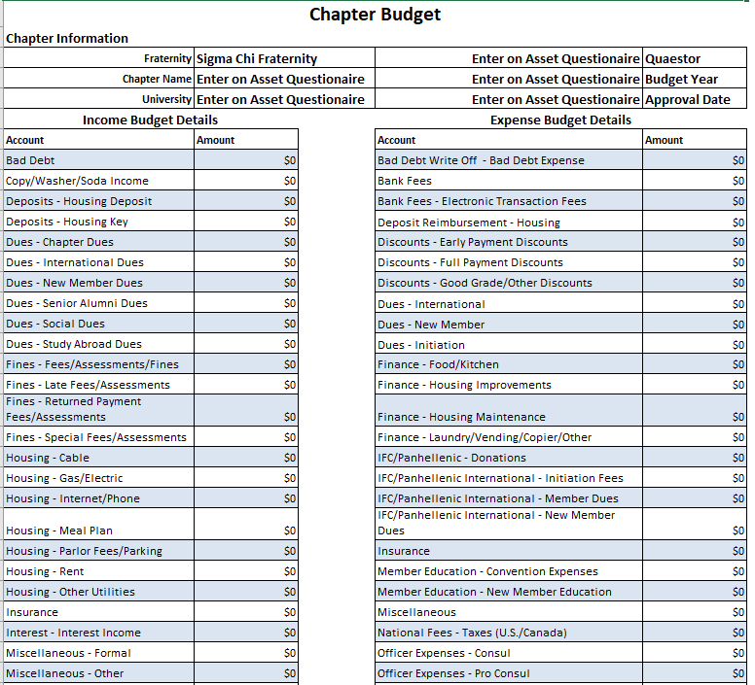
Monthly Reporting to the Chapter
Income Statements
Budget to Actual Analysis
Balance Sheet
Accounts Receivable/Brother Payment Plans
Accounts Payable
Cash Flow
Budget Adjustment Requests

Slide 8
Annual Audit of Finances
Annual Audits should be a collaborative effort with your Financial Committee and your Alumni Financial Advisor

Slide 9
Thank you!!!
Quaestor

