Slide 1
Introduction to Quaestor
Quaestor

Slide 2
What is a Quaestor?

Slide 3
Roles and Responsibilities of a Quaestor
Understand Ritualistic Obligations and Ethical Standards
Collect and Preserve All Monies Due to the Chapter
Prepare a Budget at the Beginning of Your Term
Record All Financial Transactions
Ensure All Monies Owed to the Chapter are Paid On Time
Ensure All Tax Reports are Filed Properly and On Time
Attend Sigma Chi Officer Trainings
Hold Yourself and All Members Accountable

Slide 4
Ethical Standards - Confidentiality
Privacy and Confidentiality
Respect the privacy and confidentiality of all person and entities…
Transmit Sensitive Information only to Authorized Individuals
Seek Ethical Action with Respect to the Best Interests of All

Slide 5
Ethical Standards - Confidentiality
Application of Ritualistic Statutes
Understand the Role as Described by the Ritual
Keep Accurate and Timely Records
Deliver all Monies and Financial Records as Required

Slide 6
Quaestor Competencies
Basic Understanding of Budgeting Assets and Liabilities
Act with Integrity in Every Transaction
Maintain Accurate Records
Understand your Limits
Reconcile and Audit Regularly
Accept Responsibility for your Tasks
Handle Monies Appropriately

Slide 7
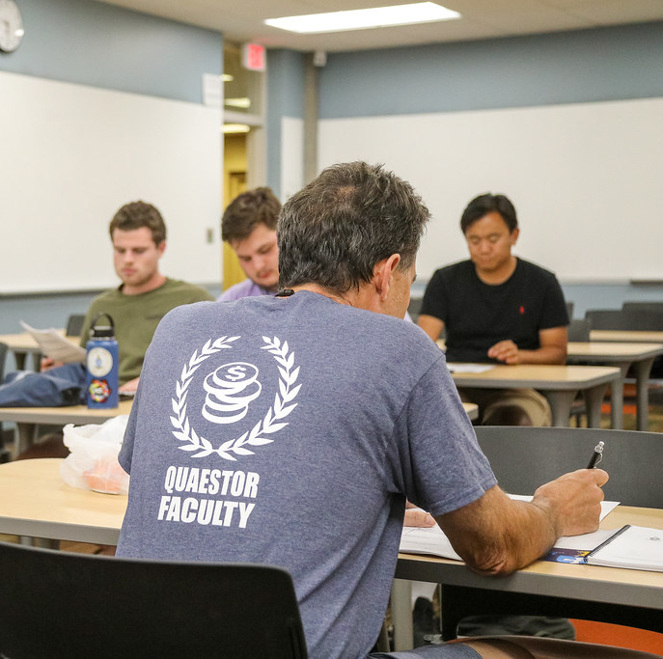
Transition and Training
As Quaestor Elect
Become Familiar with Duties of Office
Become Familiar with Chapter’s Current Financial Standing
Sigmachi.org/home/leadership-resources/

Slide 8
Thank you!!!
Quaestor

